Slide 1


SLIDE 01
Smart Study Companion
Improving Academic Productivity with AI
The Problem
Traditional weekly revision involves manually reading lectures, extracting definitions, preparing summaries, and assessing understanding.
68 min
Measured manual revision time

Slide 2







SLIDE 02
Our Solution – Smart Study Companion
THE WORKFLOW
1. Lecture
2. Summary
3. Quiz
4. Feedback
5. Revision Plan
AI responsibilities
My responsibilities
Summarization
Selecting sources
Quiz generation
Answering independently
Preliminary feedback
Verifying information
Identifying weak topics
Approving the final revision plan

Slide 3
SLIDE 03
Live Demonstration
How Smart Study Companion Works
1
Upload a lecture.
2
Generate a source-grounded summary.
3
Answer an interactive quiz question.
4
Receive feedback and identify weak topics.
5
Test whether the assistant refuses unsupported information.
Switching to live interactive application demo...

Slide 4
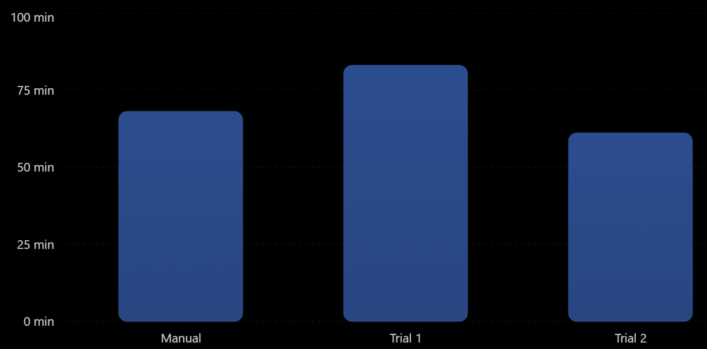
SLIDE 04
Measured Results
Revision Time Comparison
Metric | Manual | Trial 1 | Trial 2
Time | min 68 | min 83 | min 61
Quiz score | 8/10 | 6/10 | 10/10
Test Case | Result
Time | Correct explanation with source
Messy | Correct distinction between concepts
Edge | Refused unsupported information
Average AI time: 72 minutes.
Overall time change : +5.9% (4 minutes slower than manual revision ) .
Trial 2 improvement: 7 minutes faster than manual revision.
Key finding: Trial 2 was 7 minutes faster than manual revision, while the average of both AI trials was 4 minutes slower.

Slide 5


SLIDE 05
Risks & Future Plan
Controls
Key risks
• Incorrect explanations or fabricated references.
• Use approved lecture materials only.
• Overreliance on AI-generated summaries.
• Verify answers against the original sources.
• Revealing answers before the student's attempt.
• Keep final judgment and learning responsibility with the student.
30-Day Plan
Repeat revision sessions, measure time and accuracy, improve instructions, and decide whether to continue, modify, or stop.

